Slide 1

SC1015 Mini Project
Company Performance Prediction & Analysis
BCF2 - Group 6:
Jiang Lei (U2121557B)
David Tey (U2121810J)
Kelly Khoo (U2121724G)

Slide 2
Why is managing company performance important?
Supports workforce planning
04
01
Helps in efficient work allocation to maximise productivity
Boosts employee morale
Reduces employee turnover
Company Performance
Promotes growth mindset and motivates employees
Feedback sessions allow employee to raise and resolve issues
Highlights training needs
03
Identifies gaps in training to upskill employees
02

Slide 3
Motivation
Problem Definition
Prediction
01
Company Ratings & Working Happiness Score
Problem Statement
Analyse company performance in terms of
Ratings & Employees Happiness
02
Analysis
Find most important features affecting work happiness
03
Recommendation
Find anomalies companies for company rating to advise them

Slide 4
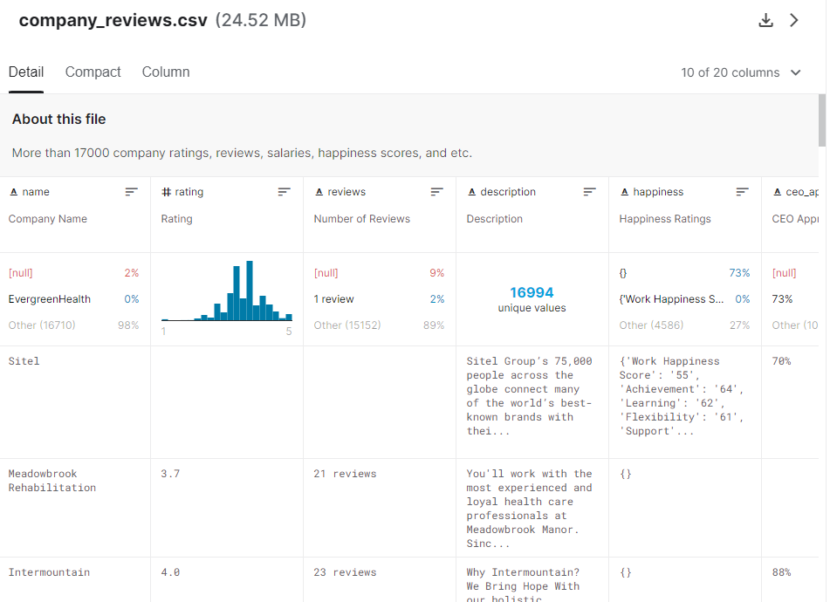
Motivation
Dataset Overview
Dataset Size
Raw dataset with 17,000 rows and 20 columns
Dataset Source
Scraped from Indeed.com website containing data from mainly US companies across 50+ industries
Dataset Overview
Containing information about employees' ratings, happiness score, revenue, salaries, etc.
Notes:
How many rows
How many columns
Dataset info (US companies)
Across many industries
Ratings based on Reviews from glassdoor

Slide 5
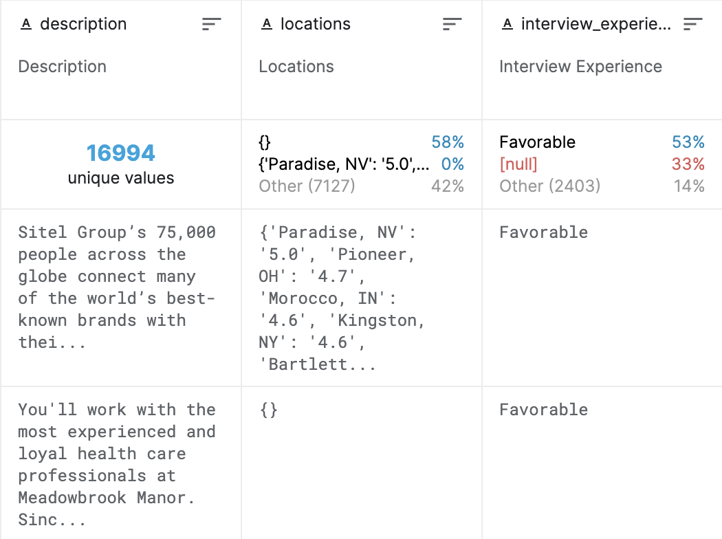
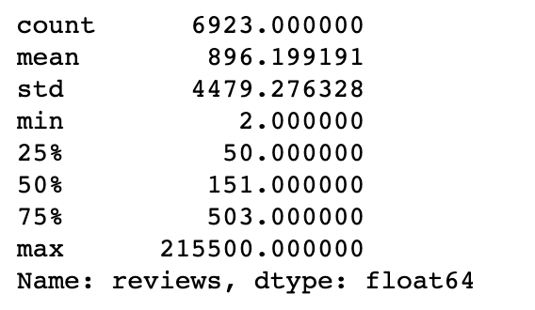
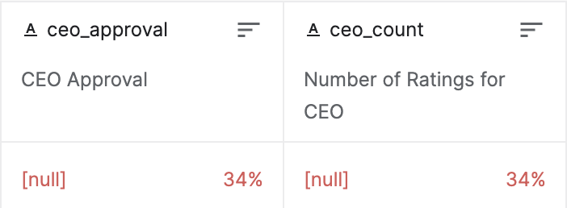
Data Pre-processing
Dataset Clean Up
01
02
03
DATA
CLEANING
Drop Null Data
Drop Irrelevant Columns
Ratings
Reviews
Industry
Employees
Revenue
Drop entries with low review values
Description
Location
Interview-related columns
Location
Website
To ensure the credibility of data
Drop data below Q1 of Reviews - 50

Slide 6
Data Pre-processing
Structured Data Preparation
01
02
03
04
Split data in “ratings” to individual columns
Modify datatype of certain columns
Categorise industry data
Calculate average salary

Slide 7
Exploratory Data Analysis
Structured Data Preparation
Uni-Variate Statistics
Statistical Summary & Distribution of
Rating & Work Happiness Score
Multi-Variate Correlation
Rating & Work Happiness Score V.S.
Salaries, Company Size, Company Culture, etc.
Analyses Across Different Industries
Find the important features for different industries, and gain new insights

Slide 8
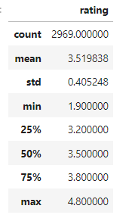
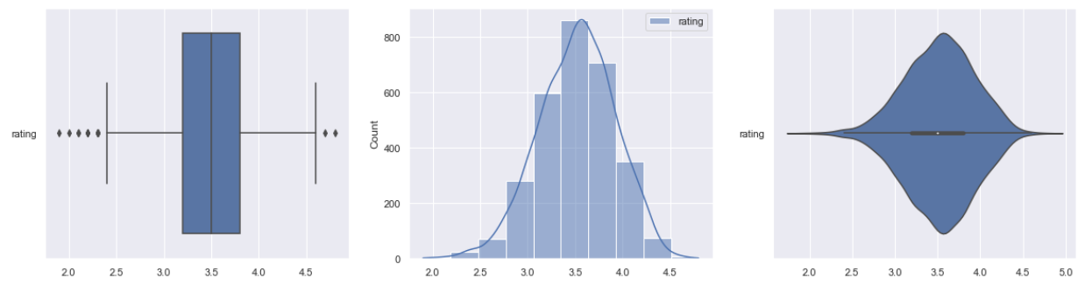
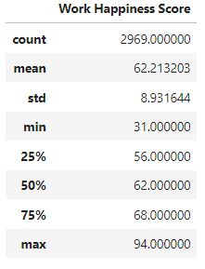
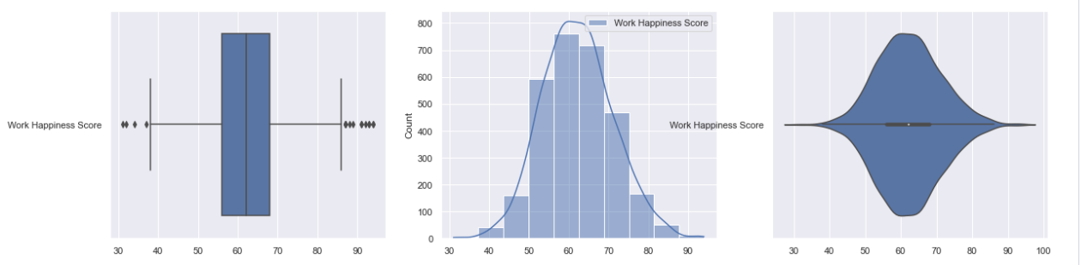
Exploratory Data Analysis
Uni-Variate Statistical Summary
Company Rating
Work Happiness Score

Slide 9
Exploratory Data Analysis
Correlation Features
Company Ratings
Work Happiness Score
General Ratings
CEO Approval
Compensation, culture, management, work/life balance, job security
Average salary
Salaries
Work/life balance
Industry
Compensation
Job security
Revenue
Management
Culture

Slide 10
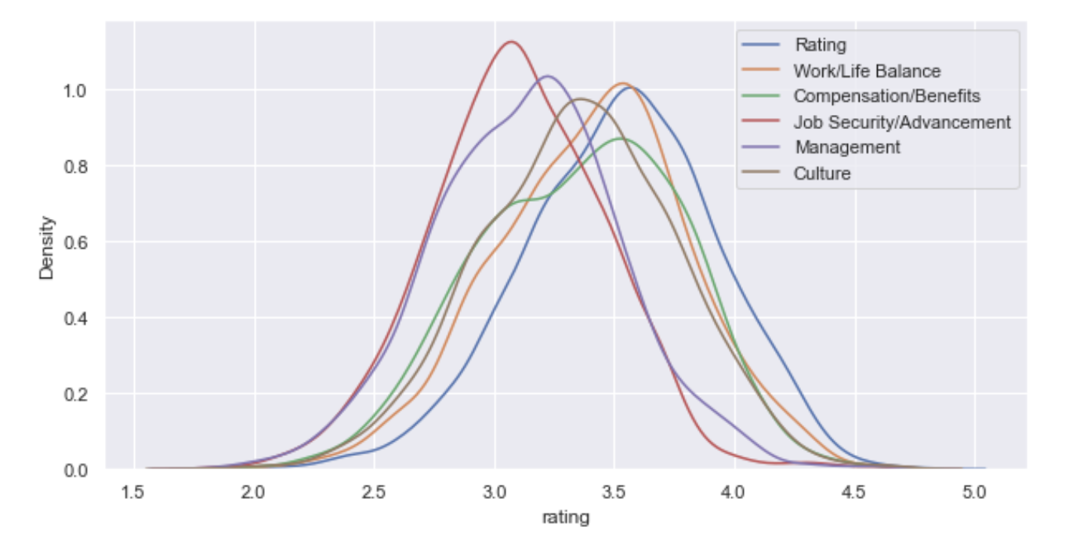
Exploratory Data Analysis
Distribution Patterns for Rating Factors
Objective
01
Find Distribution of Features to be used in prediction
02
Plot Used
KDE Density Plot
Insights
03
Similar distribution as rating
Boost our confidence in using them as features to predict

Slide 11
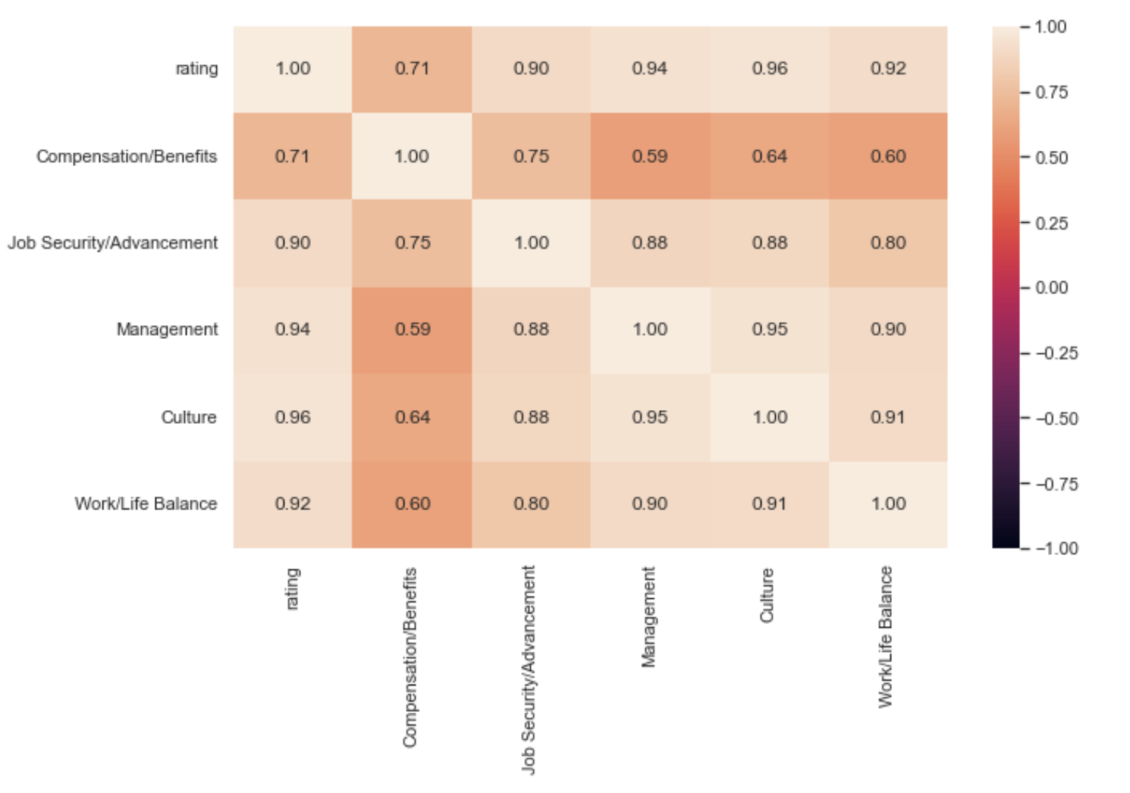
Exploratory Data Analysis
Correlation of Rating & Features
01
Insights
All factors have strong positive correlation with company rating (>=0.9)
Except for compensation/benefits (0.71)
02
Red Flags
Among the factors, many features have strong correlation with each other
Variables may not be independent of each other
May indicate Multicollinearity Issue

Slide 12
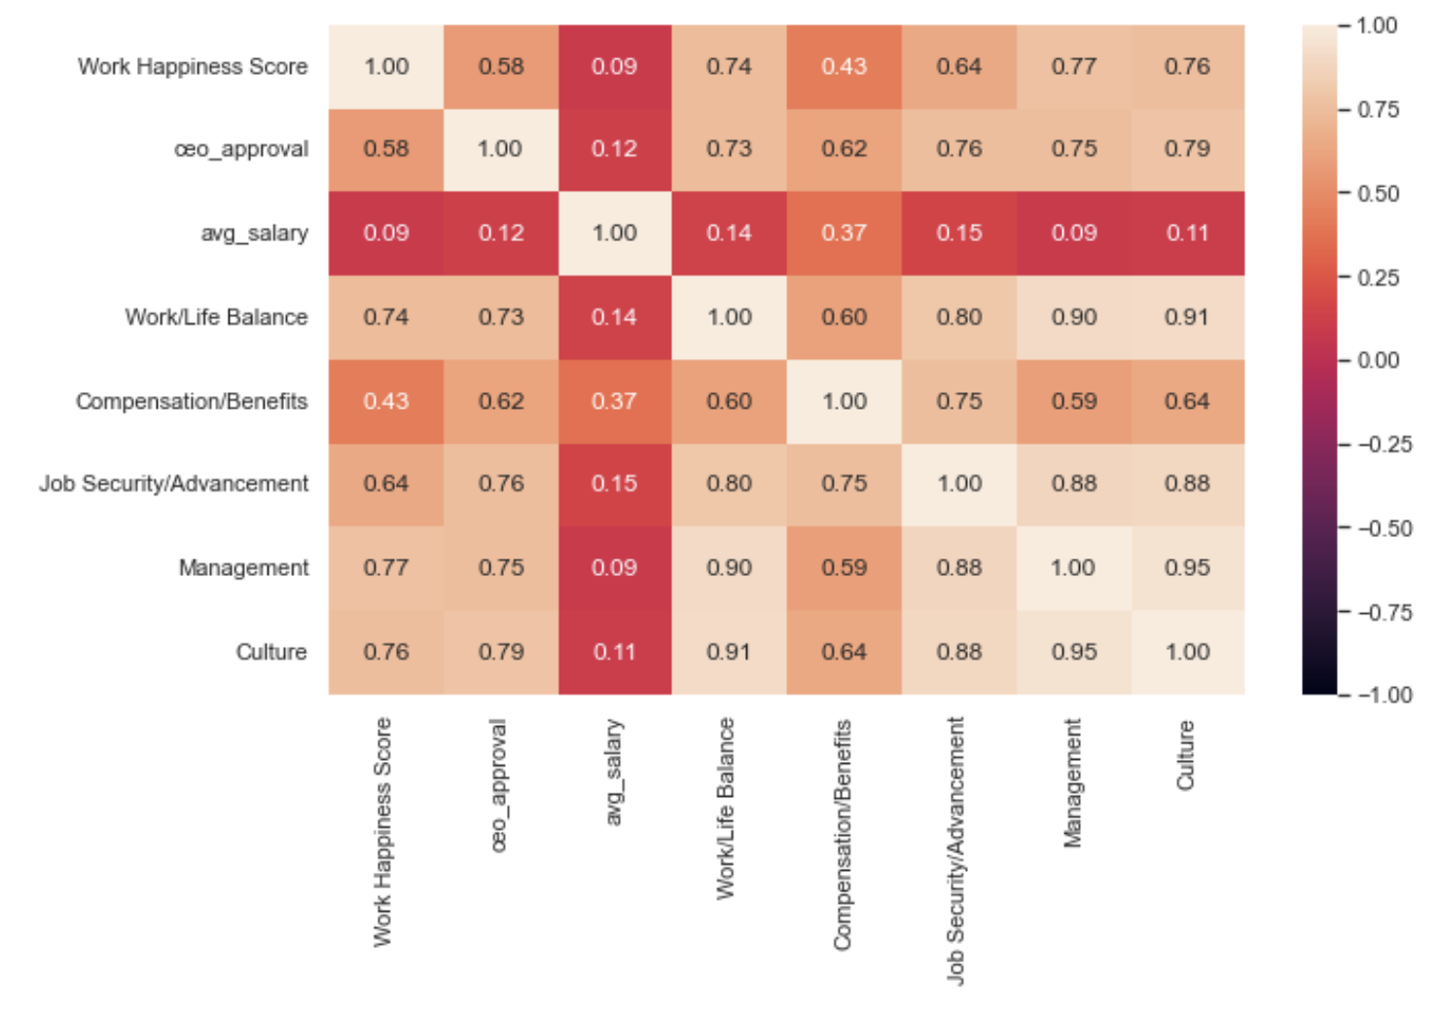
Exploratory Data Analysis
Correlation of Happiness Score & Features
01
Insights
Work Happiness have strong positive correlation with management, culture, work-life balance
While Salaries, Compensation, and CEO approval seem to have low correlation with Happiness Score
02
Thoughts
Do different industries value different factors to different extent?

Slide 13
Exploratory Data Analysis
Find Important Features for Ratings & Happiness
Across Different Industries
Financials
Telecomm
Commodities
Financial Services, Insurance, Consulting and Business Services,
Human Resources & Staffing, etc.
Financial Services, Insurance, Consulting and Business Services,
Human Resources & Staffing, etc.
Manufacturing, Energy, Mining & Utilities, Transport and Freight, etc.
Leisure
Govt Services
Real Estate
Restaurants, Travel and Leisure, Restaurants & Food Service,
Arts, Entertainment & Recreation, etc.
Education, Aerospace & Defense,
Government & Public Administration, etc.
Construction & Facilities Services
F&B
Healthcare
Retail
Food and Beverages
Financial Services, Insurance, Consulting and Business Services,
Human Resources & Staffing, etc.
Consumer Goods and Services, Automotive, Personal Consumer Services
etc.
Tech
Computers and Electronics,
Internet and Software

Slide 14
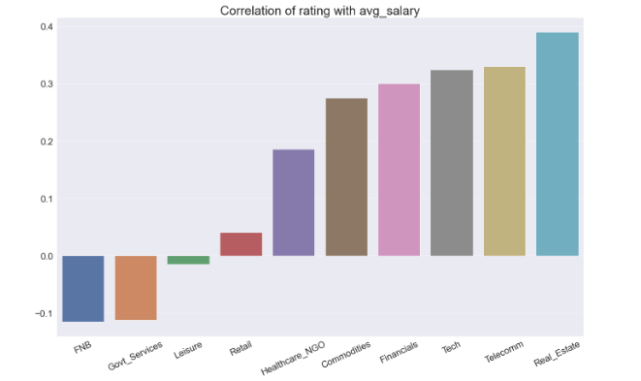
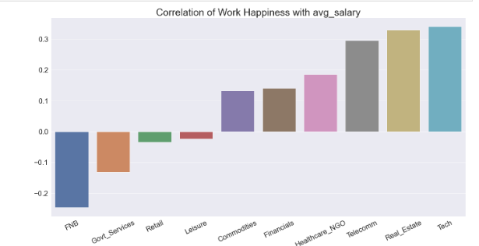
Exploratory Data Analysis
Average Salaries V.S. Ratings & Happiness (across different industries)
Insights
Average Salary does not have strong correlation with neither Ratings nor Happiness
Tech, Tele, and Real Estate has slightly higher positive correlation, but still not strong
Govt Services and FNB even have a slight negative correlation
May not be a good feature for prediction

Slide 15
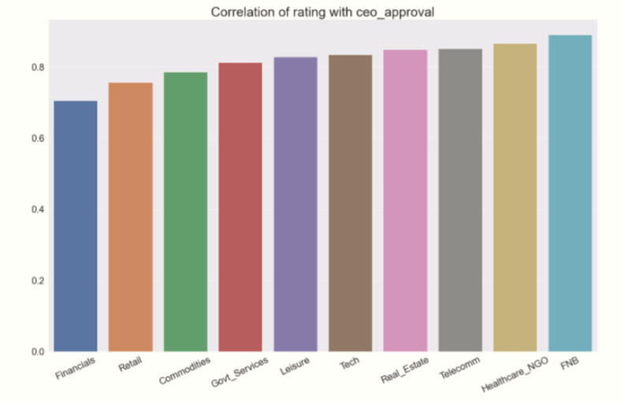
Exploratory Data Analysis
CEO Approval V.S. Ratings (across different industries)
01
Insights
A noticeable gap across industries, with the Food and Beverages industry at roughly 0.82 and the Real Estate industry at around 0.57
02
Intuitive Explanation
It relates to the level of autonomy that employees have in their work
Industries with higher levels of autonomy (Real Estate and Technology) may not feel as much presence from top management compared to more hierarchical industries (Governmental Services and Food and Beverages)
As such having a good management could be more important to these industries.
CEO Approval: percentage of employees that think CEO is doing a good job

Slide 16
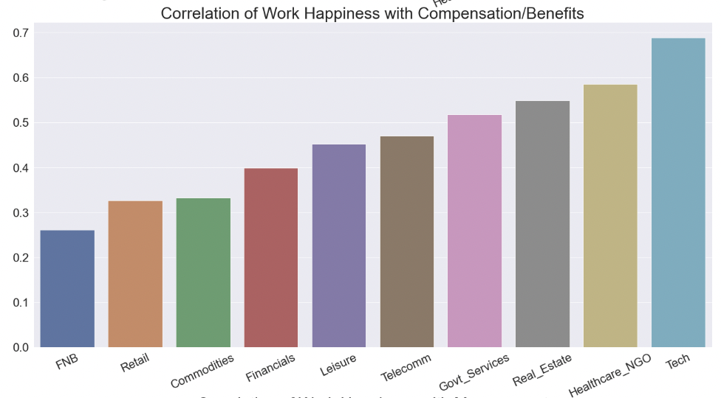
Exploratory Data Analysis
Insights of Technology Companies
01
Insights
Strong positive correlation between compensation with work happiness in the tech industry (~0.7), while other industries do not show such correlation
02
Intuitive Explanation
Be attributable to the current trend where tech companies are offering more competitive salaries
Tech Companies tends to attract talents who value compensation more
Compensation / Benefits: both monetary & non-monetary rewards, i.e., stocks vest, insurance, etc.

Slide 17
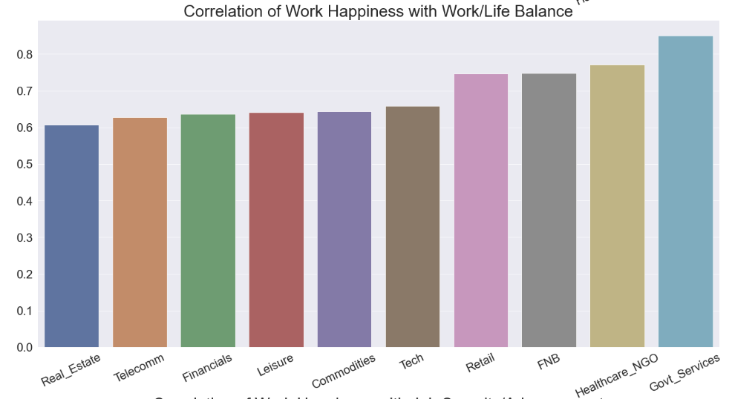
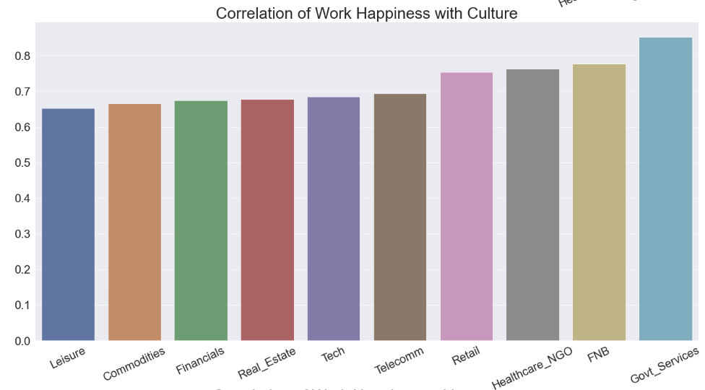
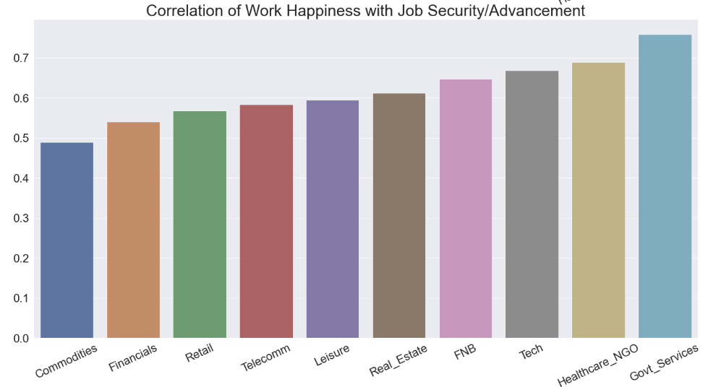
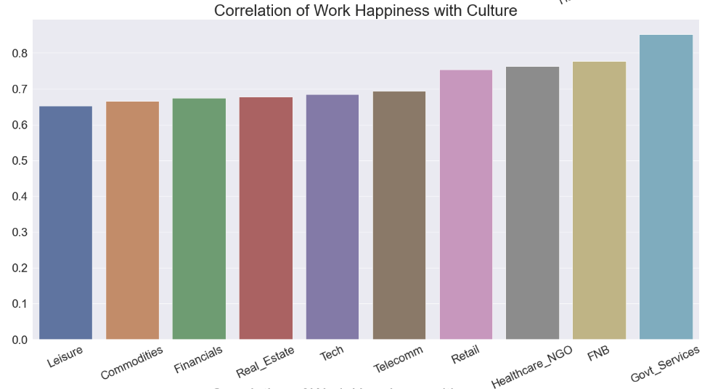
Exploratory Data Analysis
Insights of Government Service Companies
01
Insights
Governmental Services had the highest correlation between work happiness and these 4 factors
02
Intuitive Explanation
Suggests that there are external factors that may be better at explaining the ratings in the other industries.
Government jobs are typically quite different from private sector jobs.
Notes:
Change formatting of graphs

Slide 18
Machine Learning
01
Predicting Rating
Find anomalies in company rating
02
Predicting Happiness Score
Find the important factors affecting happiness score

Slide 19

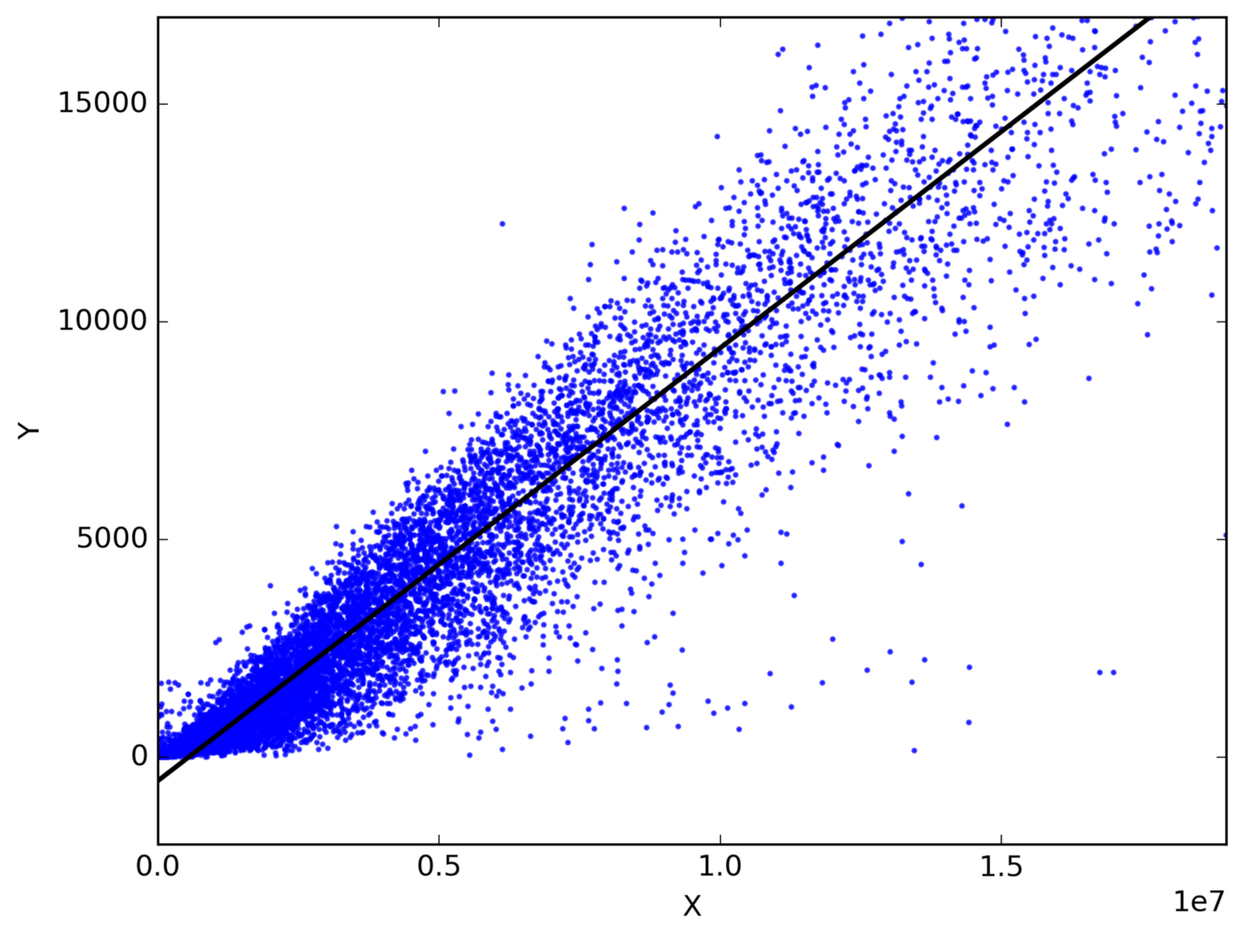
Machine Learning
Overview of Models
Ratings
Work Happiness Score
Light GBM
Linear Regression
Gradient boosting framework based on decision tree algorithm for classification etc
3 step framework:
Basic -> Stepwise -> PCA

Slide 20
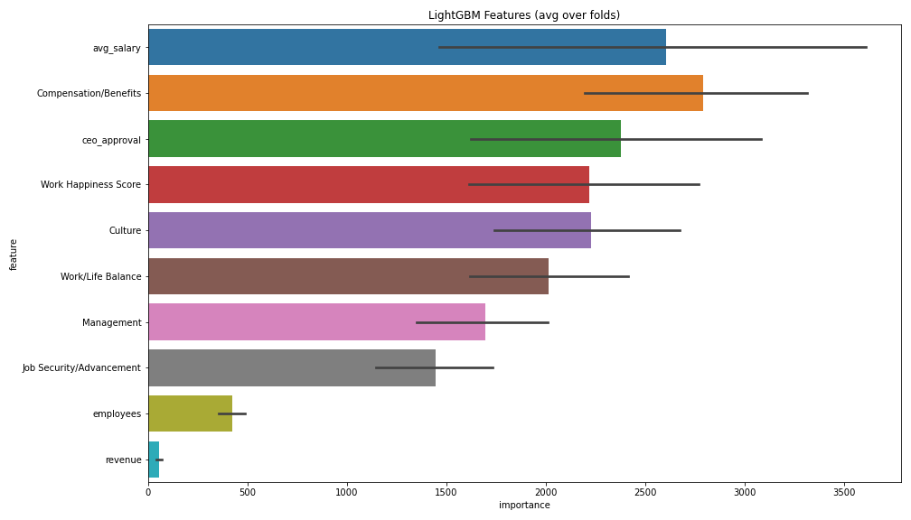
Machine Learning
Predicting Ratings – Light GBM
01
Model Performance
Highly accurate: RMSE of 0.088 on test data
Fast Calculation: within 40 seconds in max depth - 5
02
Learning Points
Importance of the various variables used in prediction for this model
Not informing the importance of these variables in improving ratings, but merely showing the weights in prediction.
Notes:
Model: linear regression
Objective: explore the importance of each variable, then do stepwise 2

Slide 21
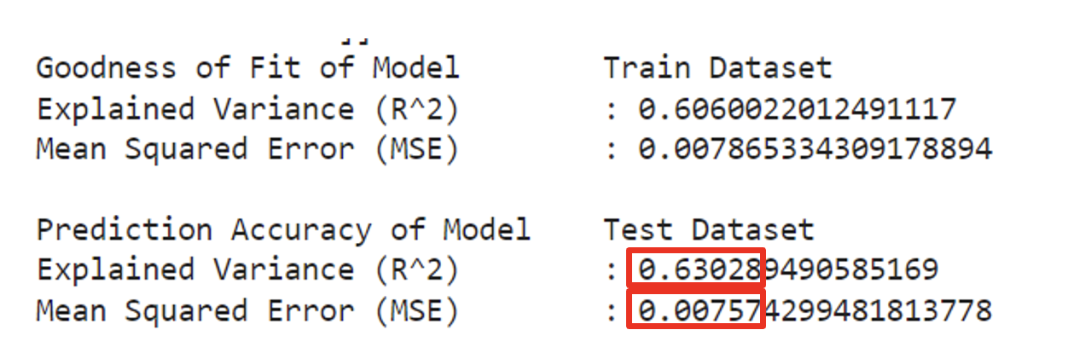
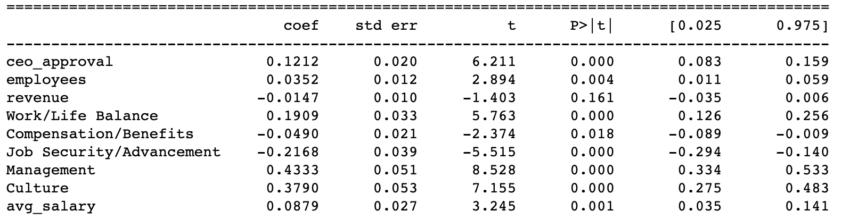

Machine Learning
Predicting Happiness Score – Linear Regression
Basic Linear Regression
01
R^2 = 0.63 (Testing dataset)
MSE = 0.00757 (Testing dataset)
- Explore the importance of each variable
Stepwise Regression (OLS)
02
Found the p-value of each variable to understand its significance
R^2 = 0.969 (Training Dataset)
R^2 = 0.618 (Testing Dataset)
- Model Overfit with 22 variables
Multicollinearity Issue
03
Regression coefficient is unstable and vary greatly from one sample to the next
Resolve this issue with PCA!

Slide 22
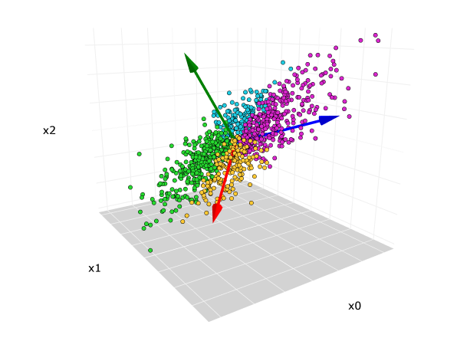
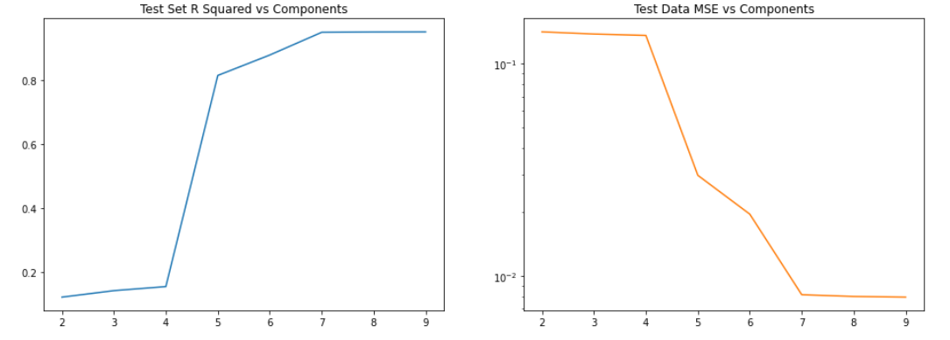
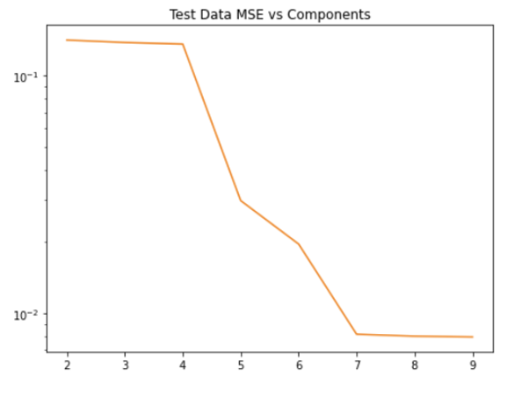
Machine Learning
Predicting Happiness Score – PCA
Summarize the information content in large data tables by means of a smaller set of “summary indices”
Large increase in R^2 from 4 to 7 dimensions
Large decrease in MSE from 4 to 7 dimensions
Reduced number of variables from 22 to 7 principal components
Improved model accuracy, R^2 > 0.9

Slide 23
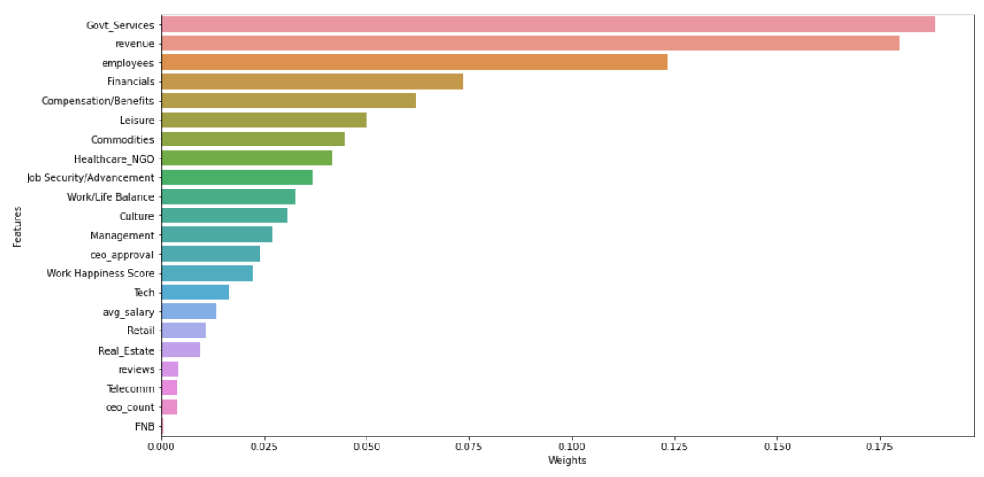
Machine Learning
Predicting Happiness Score – PCA
Measure of relative importance of the different features
Insights
01
Industries ranked 1st with Government Services
Revenue 2nd and Employee 3rd which possibly indicate that company size affects happiness
02
Surprising Findings
Previously did not find any meaningful relationship between revenue and employees (Company Size) with work happiness

Slide 24
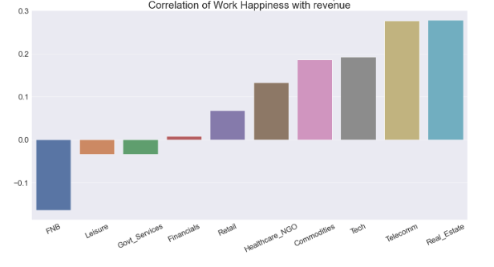
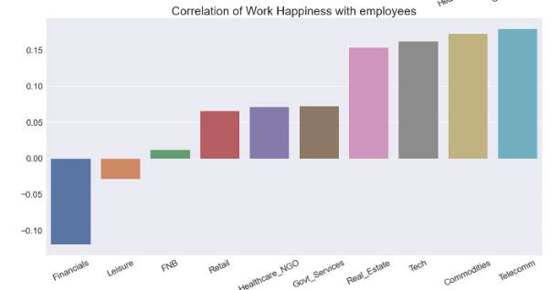

Conclusion
Insights Gained
Correlation between revenue with work happiness was around -0.15 for the F&B industry
While almost 0.3 for telecommunication and real estate
Increased predictive power by combining with PCA analysis

Slide 25

Conclusion
Insights Gained
Most Predictive Power
Least Predictive Power
Compensation
Employee
CEO Approval
Revenue
Culture
Average salary
Work/Life balance
Management

Slide 26


Conclusion
Insights Gained
02
01
Different industries have different priorities due to these factors
Culture
Compensation Structure
03
04
Hierarchies
Personalities

Slide 27
Conclusion
Outcome
Improved Linear Regression Model with PCA
Achieve Our Stated Goals of Predicting Work Happiness Score
99 %
Accurate Regression Model: Light GBM
Achieve Our Stated Goals of Predicting Company Rating
99 %

Slide 28
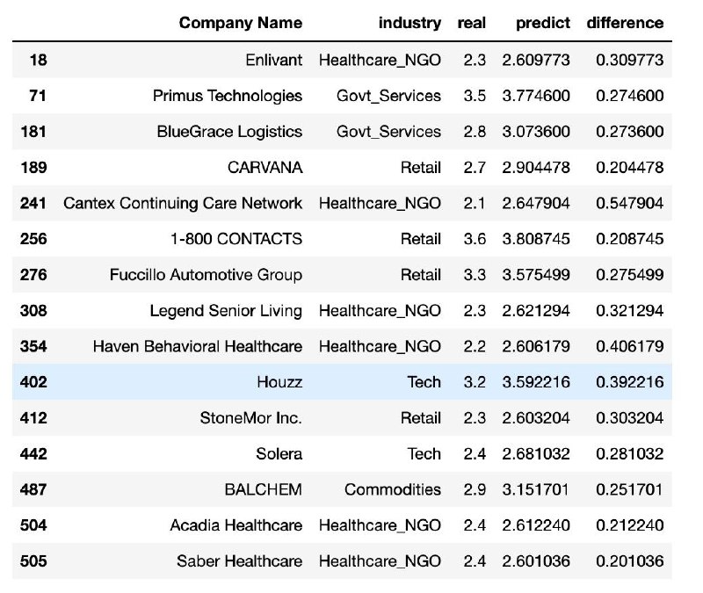
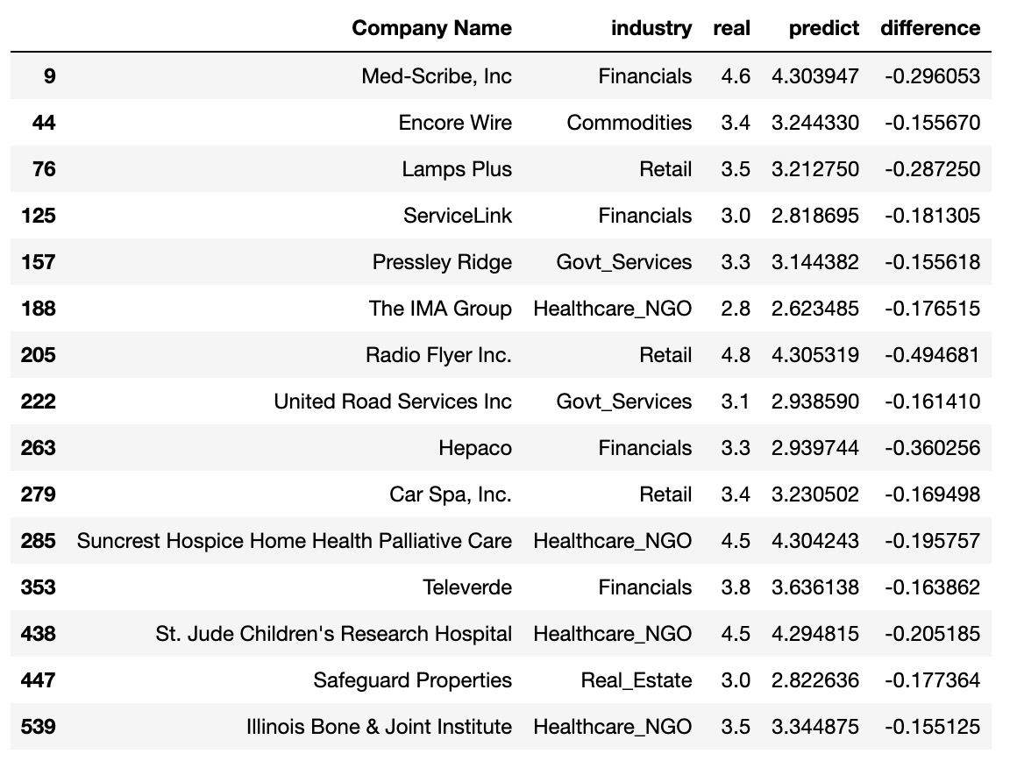
Conclusion
Recommendations
01
Future Opportunities
Overrated
Underrated
Find external factors that could explain this deviation
02
Serve as a Starting Point For Managers
Use our industry classifications as a benchmark to compare their companies with
03
Inspired for Targeted Improvements
figure out what is most important for their employees
eventually re-evaluate their policies to maximise employees’ work happiness

